Slide 1
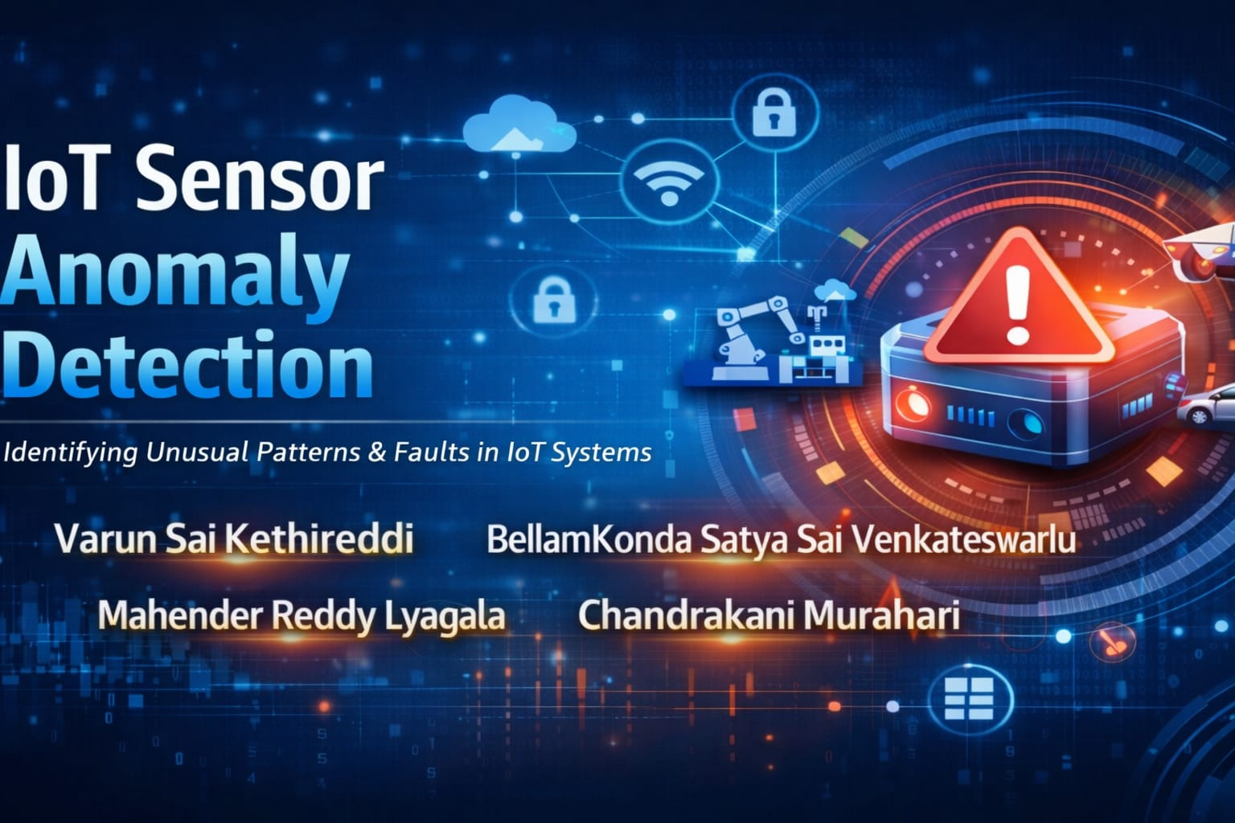

Slide 2
Project Objective
IOT devices generate large volumes of sensor data continuously, requiring efficient real-time processing and monitoring.
Without automated systems, detecting abnormal sensor behavior is difficult, leading to device failures, downtime, and operational losses.
This project builds a scalable data pipeline to enable real-time anomaly detection and proactive monitoring of IoT systems.
The main objectives of this project are:
1. Build a real-time streaming data pipeline using Amazon Kinesis.
2. Implement Medallion Architecture (Bronze, Silver, Gold layers) in Databricks.
3. Clean and transform raw IoT sensor data.
4. Apply anomaly detection techniques using Z-score.
5. Provide real-time dashboards for monitoring sensor health.
6. Trigger Slack alerts for critical anomalies.
7. This enables proactive monitoring and predictive maintenance.

Slide 3
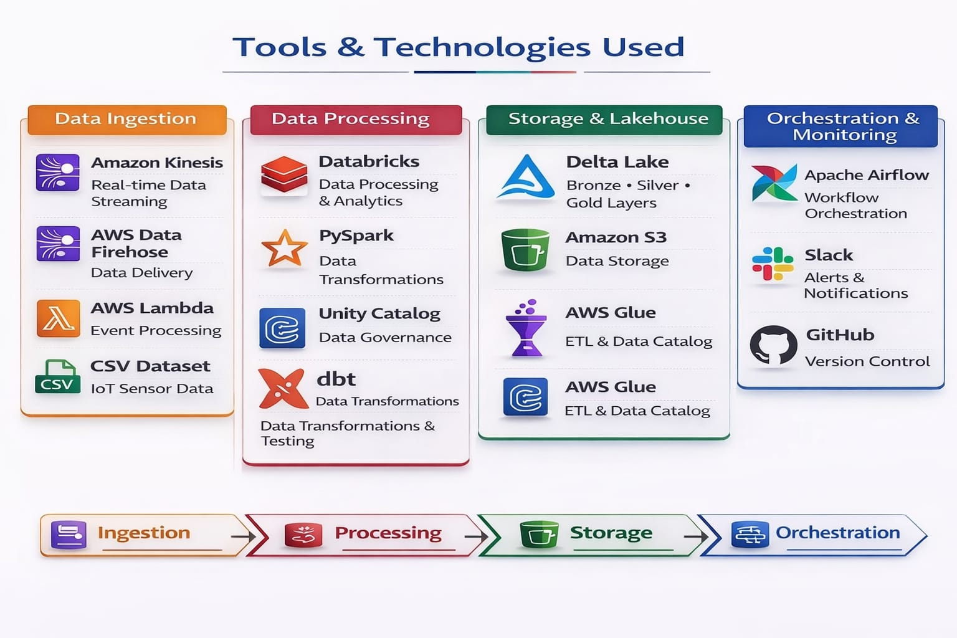

Slide 4
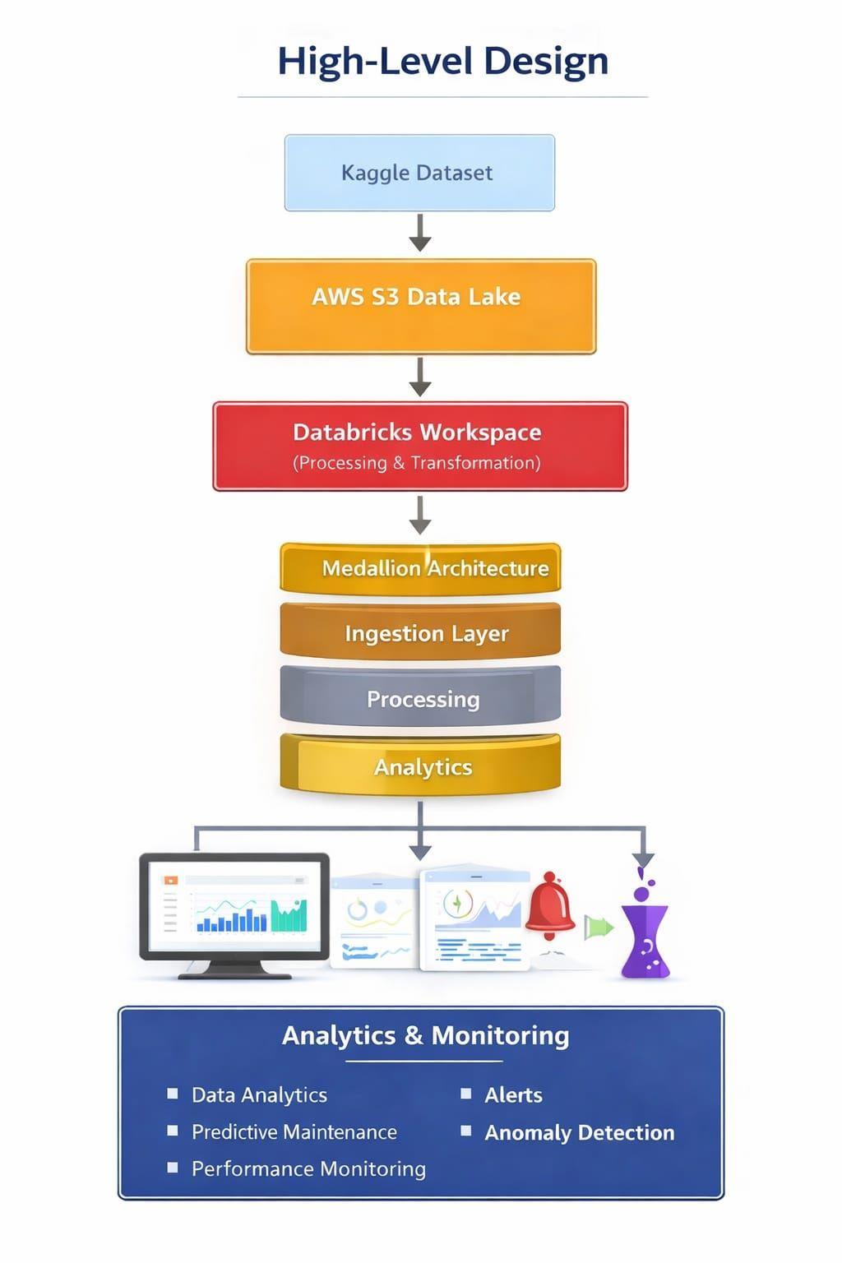

Slide 5
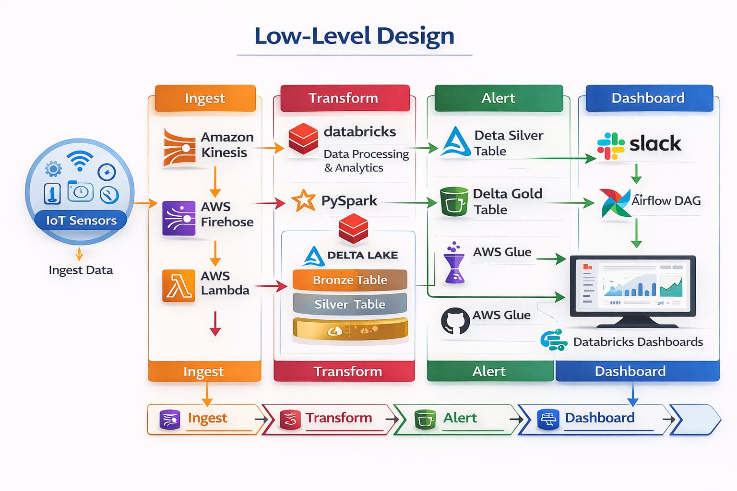

Slide 6
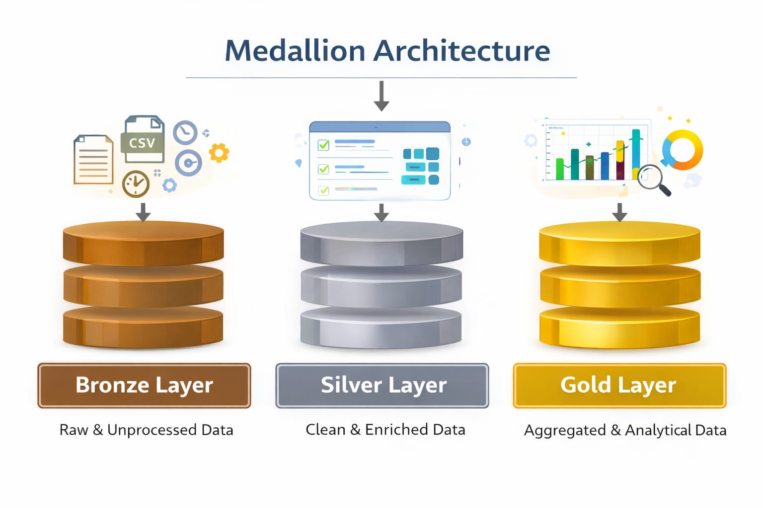
Medallion Architecure

Slide 7
BRONZE
SILVER
GOLD
Ingested raw IoT sensor dataset (CSV) into the data pipeline.
Stored the incoming raw data in AWS S3 Data Lake for scalable storage.
Loaded raw data into Databricks Delta tables in the Bronze layer.
Preserved the original structure and schema of the data without transformations.
Maintained data lineage and traceability to allow reprocessing when required.
Cleaned the raw IoT sensor data received from the Bronze layer.
Removed invalid or missing sensor readings to improve data quality.
Standardized column formats and data types for consistency.
Filtered noise and incorrect records from the dataset.
Applied data transformations using PySpark in Databricks.
Stored the processed and validated data into Silver Delta tables for analytics.
Created analytics-ready datasets from the processed Silver layer data.
Aggregated IoT sensor data to generate device performance metrics.
Calculated anomaly detection indicators for monitoring abnormal sensor behavior.
Generated device utilization and operational statistics.
Prepared datasets for real-time monitoring dashboards in Databricks.
Enabled business insights and decision-making through analytical tables.
Supported predictive maintenance analysis using device health metrics.
Integrated alerting mechanisms (Slack notifications) for anomaly events.

Slide 8
Error Handling and Data Quality Checks
Implemented data validation checks to ensure only valid IoT sensor records are processed.
Filtered null values, corrupted records, and invalid sensor readings during data transformation.
Applied schema validation while ingesting data into Bronze and Silver layers.
Logged errors and abnormal records into separate monitoring logs for debugging.
Implemented anomaly detection checks using Z-score to identify abnormal sensor behavior.
Integrated Slack alerts for high anomaly rates to notify the monitoring team in real time.

Slide 9
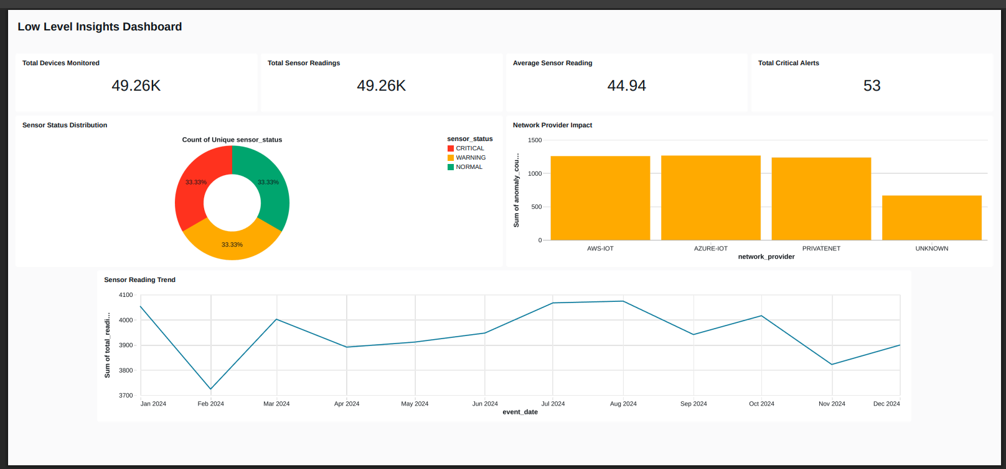
DashBoards

Slide 10
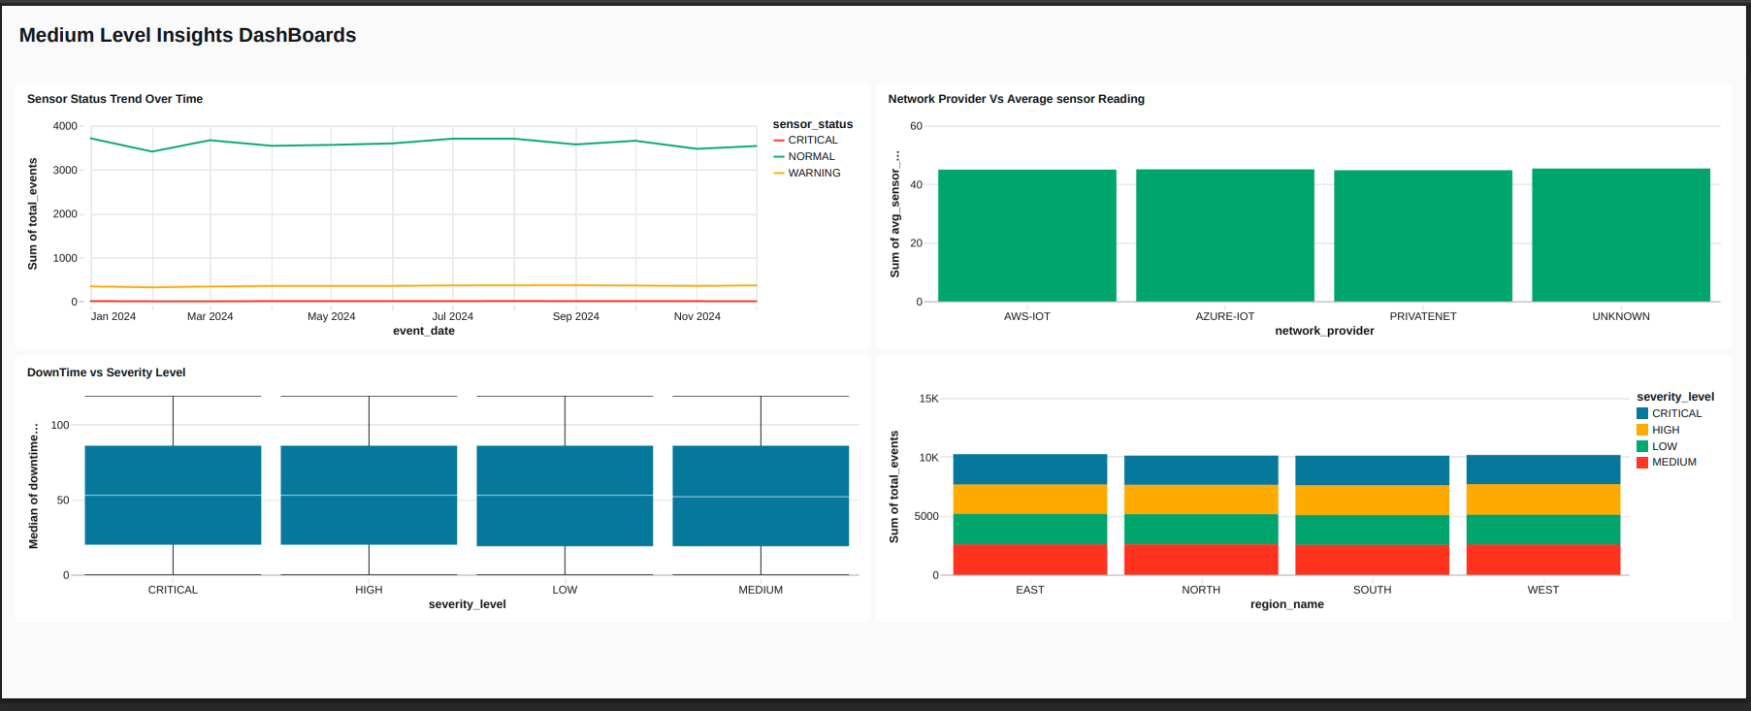

Slide 11
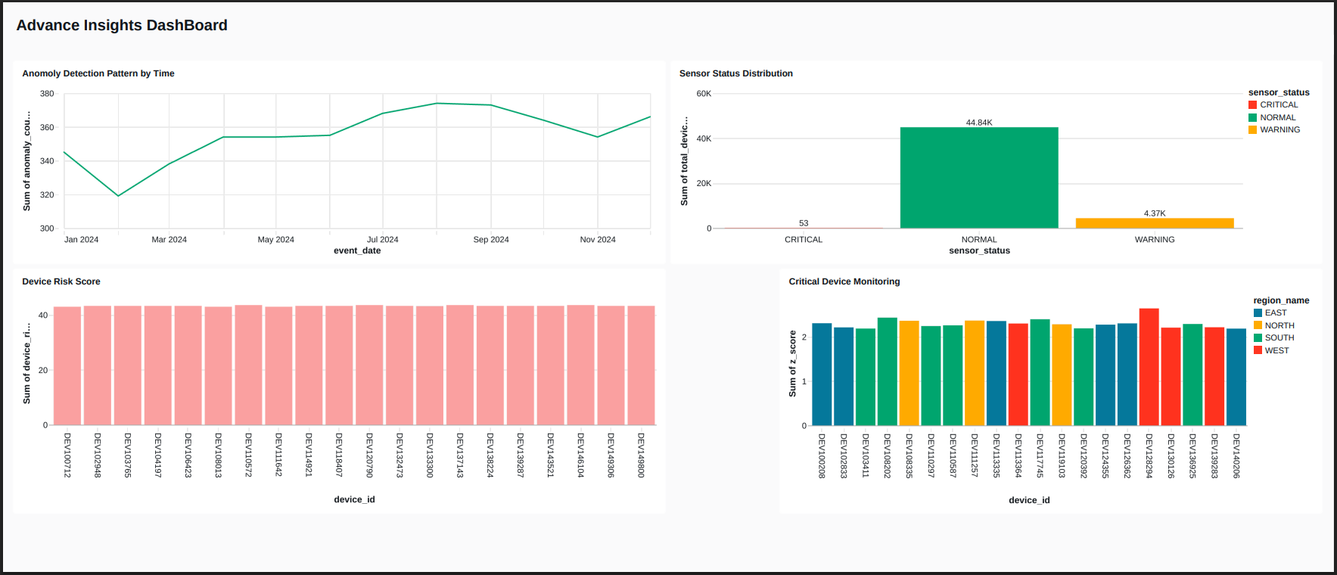

Slide 12
AirFlow(Pipeline Orchestration)
Designed an automated data pipeline workflow to manage the end-to-end IoT data processing.
Used Apache Airflow DAG to orchestrate different pipeline stages.
Scheduled pipeline execution to run automatically at defined intervals.
Triggered Databricks notebooks for Bronze, Silver, and Gold layer processing.
Managed task dependencies to ensure proper execution order of the pipeline
Implemented monitoring of pipeline runs and task execution status.
Integrated Slack notifications for pipeline alerts and anomaly events.
Enabled reliable and scalable workflow automation for continuous data processing.

Slide 13
Alerts/Monitoring/Logging
Implemented real-time anomaly detection monitoring to track abnormal IoT sensor readings.
Configured Slack notifications to alert the team when anomaly rates exceed defined thresholds.
Monitored pipeline execution status using Apache Airflow DAG runs.
Tracked data processing stages across Bronze, Silver, and Gold layers.
Logged pipeline activities and processing details for debugging and auditing.
Enabled continuous monitoring of device performance and sensor behavior through dashboards.

Slide 14
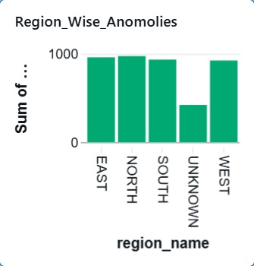
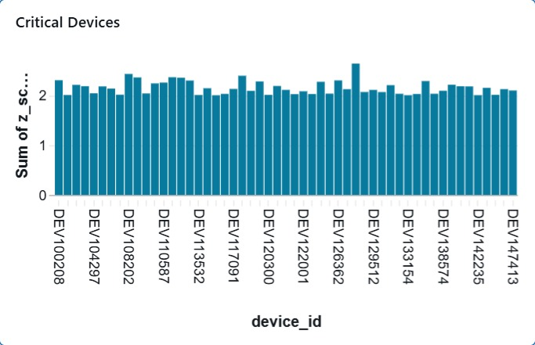
Data Build Tools
Integrated dbt in the Gold layer to perform advanced transformations on IoT sensor data.
Used existing fact and dimension tables (fact_device_monitoring, dim_sensor, dim_location, dim_time) as input sources.
Built dbt models to generate insights like device health analysis, anomaly detection, downtime analysis, and critical device monitoring.
Created modular SQL models to improve scalability, reusability, and maintainability of the pipeline.
Applied data quality tests (like not null, unique) using dbt to ensure accurate and reliable data.
Materialized dbt models as tables in Databricks Delta Lake, which are used for dashboards and monitoring.

Slide 15
Testing
Developed PyTest unit tests to validate the Bronze, Silver, and Gold layer tables.
Verified that all required tables are created successfully in the pipeline.
Checked that data is properly loaded and row counts are greater than zero.
Ensured schema validation and correct column names across all tables.
Performed data quality checks such as duplicate detection and invalid value filtering.

Slide 16
Business OutCome
Enables real-time monitoring of IoT sensor data to track device performance.
Detects anomalies early, helping prevent potential device failures.
Reduces equipment downtime and maintenance costs through proactive alerts.
Improves data reliability and decision-making using clean and structured datasets.
Provides actionable insights through dashboards and analytics for operational teams.
Supports predictive maintenance strategies for better resource planning.
Builds a scalable and automated data pipeline architecture for future IoT systems.

Slide 17


